Slide 1
Global Governance Workstream
February 2020

Slide 2
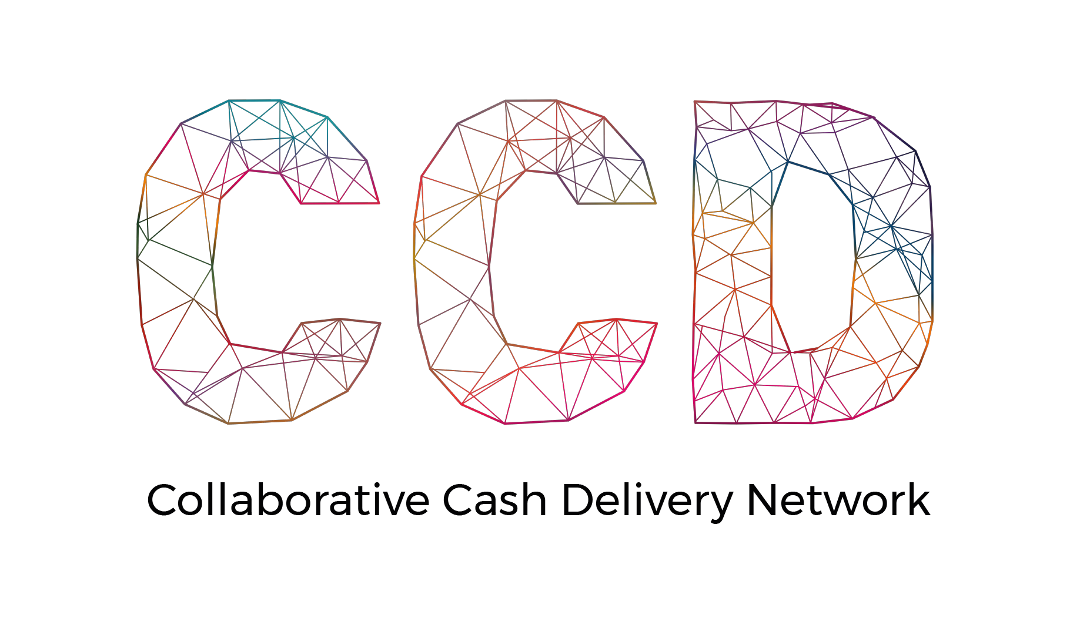
find a better way to meet humanitarian needs
improve efficiency and effectiveness of cash programming through collaboration
deliver scale and preserve diversity in the humanitarian ecosystem
influence the changing humanitarian landscape
CCD
PURPOSE
TRANSFORMATION
Notes:
Our members believe greater collaboration will enable the humanitarian sector to bring the best available actors in a given context into adaptive cash and voucher assistance (CVA) partnerships that deliver timelier and more impactful CVA to people affected by crises.
Our goal is to transform CVA to find a better way to meet humanitarian needs and influence the changing landscape by remodelling the way organisations collaborate around cash and voucher programming. Through a widely adopted and consistent platform of collaboration standards, complemented by facilitated partnership brokering, we strive to work together seamlessly. Actors will be able to combine the best of their strengths to meet the complex challenges of humanitarian response quickly and easily. We endeavour to move the cash landscape from a disconnected patchwork of dominant actors to an evolving ecosystem that reduces barriers to entry, generates greater impact and is constantly adapting to the future operating environment.

Slide 3
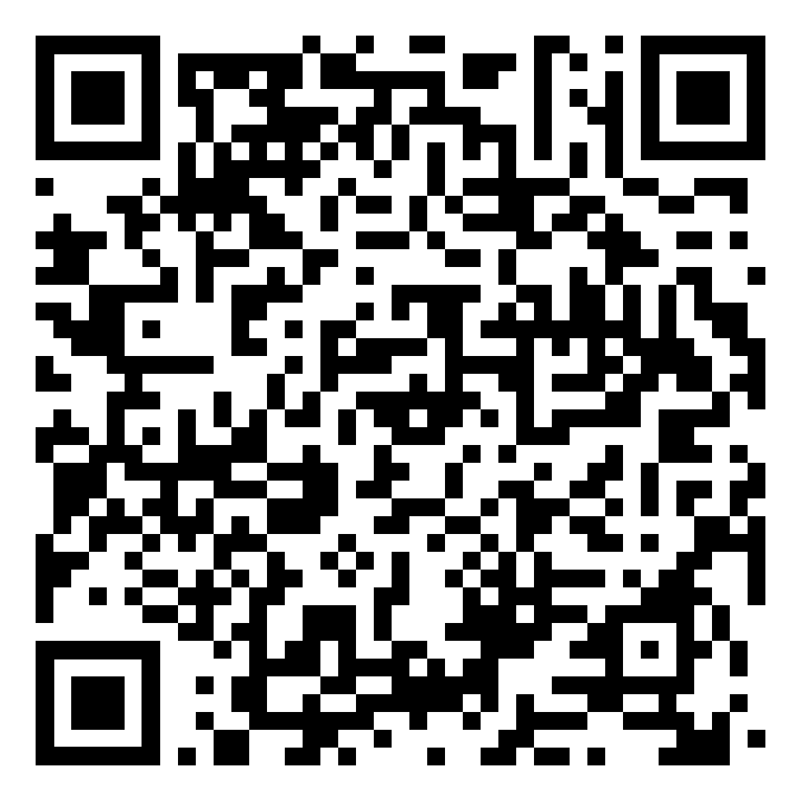
WE PROMOTE AND SUPPORT EASY, CUSTOMIZABLE AND SCALABLE COLLABORATION ACROSS THE CASH VALUE CHAIN
OUR
OBJECTIVE
COLLABORATION
Want to know more about collaborative cash? Scan for more details about CCD’s approach .
Notes:
CCD promotes and supports easy, customisable, and scalable collaborations across the cash value chain.
Partners in the CCD network are establishing norms of collaboration across the CVA value chain and increasing opportunities to work together. Within each country, the network forms rapid, reliable partnerships that share responsibilities and harness the best of each organisation to improve the efficiency and effectiveness of our cash programmes to:
better serve affected populations
avoid duplication
address technical challenges more effectively
capitalise on the strengths of each actor
and harness the power behind combined voices to influence advocacy.

Slide 4
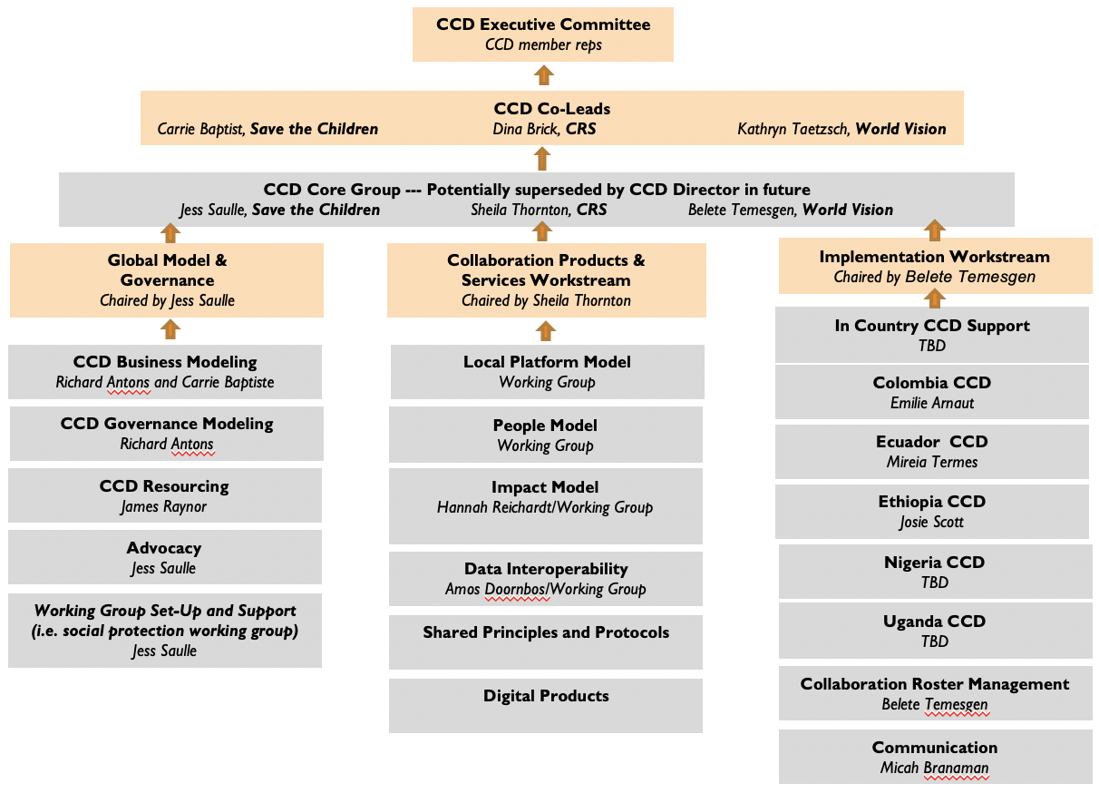
What does the CCD look like at the global level?
Global Model and Governance
Chaired by Jess Saulle
CCD Business Modelling
Jess Saulle
CCD Governance Modelling
Jess Saulle
CCD Resourcing
Nour Talli
Advocacy
Jess Saulle
Working Group Set-Up and Support
Jess Saulle or workstream lead
Notes:
GLOBAL MODEL & GOVERNANCE
Business model development and related longer-term governance
Interim governance structure and membership
Resourcing the CCD
Advocacy and socialisation
COLLABORATION PRODUCTS & SERVICES
Local CCD Model
Collaboration Toolkit
People Model
Training curriculum development
Conducting training
Roster development
Impact Model
Impact model
MEAL framework
Evaluations
Data (Interoperability)
Data sharing agreement finalization and pilots
Ongoing technical assistance as needed
Data trust research and development
Supply Chain (Interoperability)
Research and piloting common procurement standards, framework agreements and other solutions
Digital Products
Modeling tool
Marketplace mapping
Collaboration analytics
Overall response environment analytics
IMPLEMENTATION
Country support and scaling:
Year One: 5 CCD platforms opened
Year Two: 10 CCD platforms opened
Year Three: 15 CCD platforms opened
Communications
Roster management

Slide 5
Global Model and Governance workstream
CCD Business model
Longer term model for the CCD
CCD governance
Longer term governance structure related to business model
Interim governance related to membership needs
CCD resourcing
Resources (funding and pro-bono) to develop the CCD.
Socialisation
Present/support presentation at events; in-country
Advocacy
Ad-hoc advocacy for the moment
Need to be more strategic
Support to working group set-up (if cross-workstreams)
Support to set-up
Support with ad-hoc requests
Global Model and Governance
Chaired by Jess Saulle
CCD Business Modelling
Jess Saulle
CCD Governance Modelling
Jess Saulle
CCD Resourcing
Nour Talli
Advocacy
Jess Saulle
Working Group Set-Up and Support
Jess Saulle or workstream lead
Notes:
CCD Business model: to take informed choices as to how to structure and govern CCD for the long term. Timeline:
1. Mark Goldring/Penny Lawrence’s consultancy: Define issues to be resolved, decisions and choices to be made and options related to them but not recommending a specific model or choice. Interviews with co-lead agencies; humanitarian directors, CEO, other networks.
Example of issues are around being transformative but focusing on cash delivery aspects only; balancing standardisation and providing room for contextualisation, etc.
2. Research in the long list of options to define pros and cons (incl. financial restrictions, legal framework, sustainability options
3. choice of the most viable option
Governance modelling: to be seen in two phases:
Interim governance.
Currently, we are revising the governance structure based on ExCom feedbacks these include new structure and related ToRs. In the next weeks, we will engage with the ExCom to get feedbacks.
We will reflect the decisions in the interim MoU
Longer term governance: once we have the chosen business model option, we will develop the most conducive governance model for it
Resourcing: identification of potential funders, including corporate, philanthropy, and institutional donors to support the development of learning, products, roster, training, initial deployment, digitalization, advocacy.
Resourcing sub-working coming steps are:
A revision of the overall CCD Concept Note/Master Budget and breaking it down in a series of concept notes that can be socialised to donors/partners.
Develop a group of grant/fundraising experts and the related coordination mechanisms to approach various donors
Advocacy:
Most of our advocacy work is ad-hoc, either as part of the Grand Bargain or in reaction to other’s positioning.
Need to have a stronger plan and be active to highlight barriers to a more collaborative effort. Example: Messages coming from donors are mixed, strong rhetoric and aspiration for a better (e.g. more inclusive, transparent, connected, etc.) humanitarian system, but at national level, the need for policy and compliance, track records and traditional accountability balances these reform aspirations.
Socialisation: This area of work spans across my role and the communication role. It includes featuring at events and supporting CCD members to represent the work done in the CCD.
Examples: ALNAP annual event marketplace; HNPW presentation; Cash week; support Global refugee Forum pledge from Colombia; presentations to German NGO forum; presentation to CWG in countries.
Support to working group set-up: support working groups in set-up phase (provision of contacts and material)+ ad-hoc requests (for instance support the social protection WG with a animation specialist during the cash week)

Slide 6
Global Model and Governance workstream
CCD Business model
WorldVision money for the consultancy.
SCUK General Funds for salaries
Looking for funding/pro-bono to support research in detailing the various options
CCD governance
Current pro-bono from Allen&Overy (Legal firm) to support the interim MoU
SCUK General Funds for salaries
Longer term governance – need funding or pro-bono to support the design of the governance structure and MoU (management consulting and Legal)
CCD resourcing
SCUK General Funds for salaries
Socialisation
SCUK and WV funds for salaries
need funding for travel budget and publications
Advocacy
Need funding for an advocacy specialist or advocacy expert support
Support to working group set-up
Co-lead agency funds
Global Model and Governance
Chaired by Jess Saulle
CCD Business Modelling
Jess Saulle
CCD Governance Modelling
Jess Saulle
CCD Resourcing
Nour Talli
Advocacy
Jess Saulle
Working Group Set-Up and Support
Jess Saulle or workstream lead

Slide 7
THANK YOU
collaborativecash.org

