Slide 1
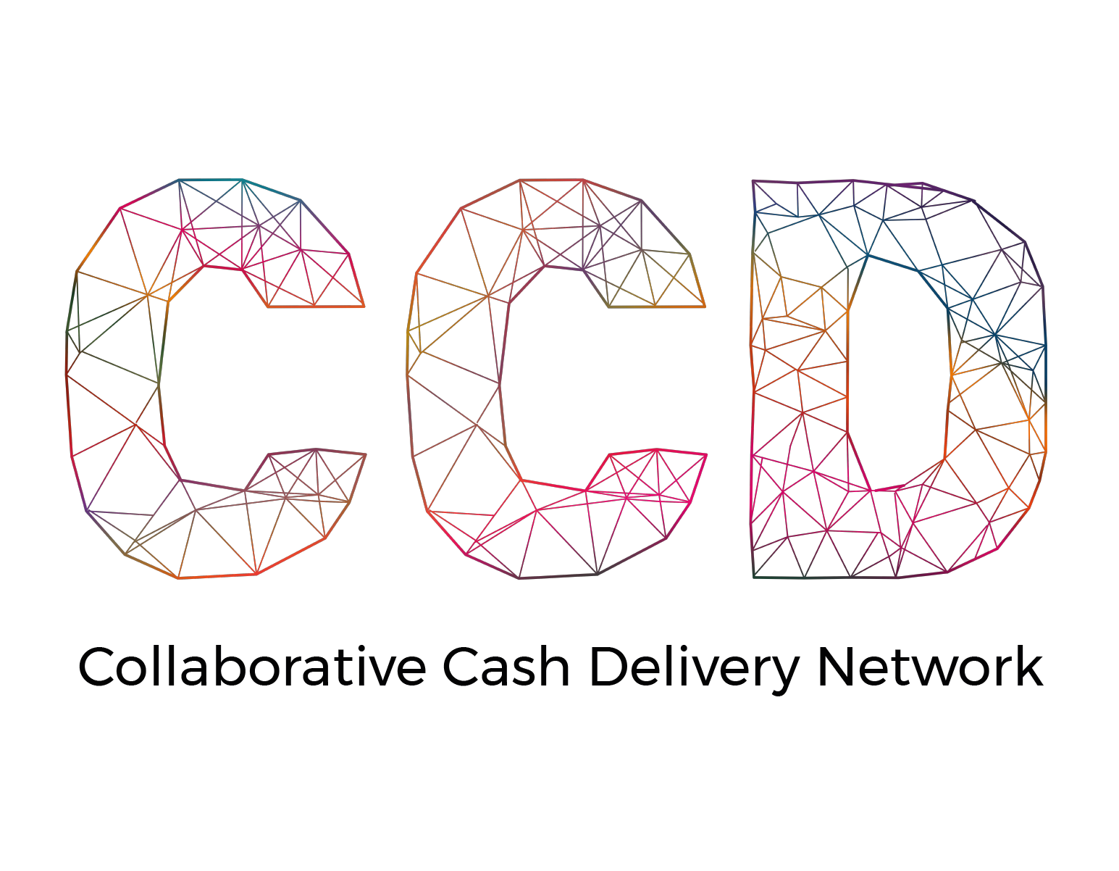
INTRODUCING
Collaborative Cash Delivery Network

Slide 2
FOUNDING MEMBERS
Notes:
Collaborative Cash Delivery (CCD) Network is a global network of 15 international non-governmental organisations (NGOs) who operate in every global humanitarian crisis that provides cash programming. CCD’s partners are estimated to deliver 80% of the ‘last mile’ cash assistance. Due to the diverse expertise and long-term global footprint of its membership, the CCD network is able to reach the most marginalised and hard to reach populations in a variety of complex humanitarian disaster contexts.
Members include: ACF, ACTED, Adeso, CARE, Concern, CRS, DCA, DRC, IRC, Mercy Corps, NRC, OxFam, Relief International, Save the Children, and World Vision
In addition to any global member operating in country, national networks can invite any local NGO / humanitarian actor in the cash sector to join.

Slide 3
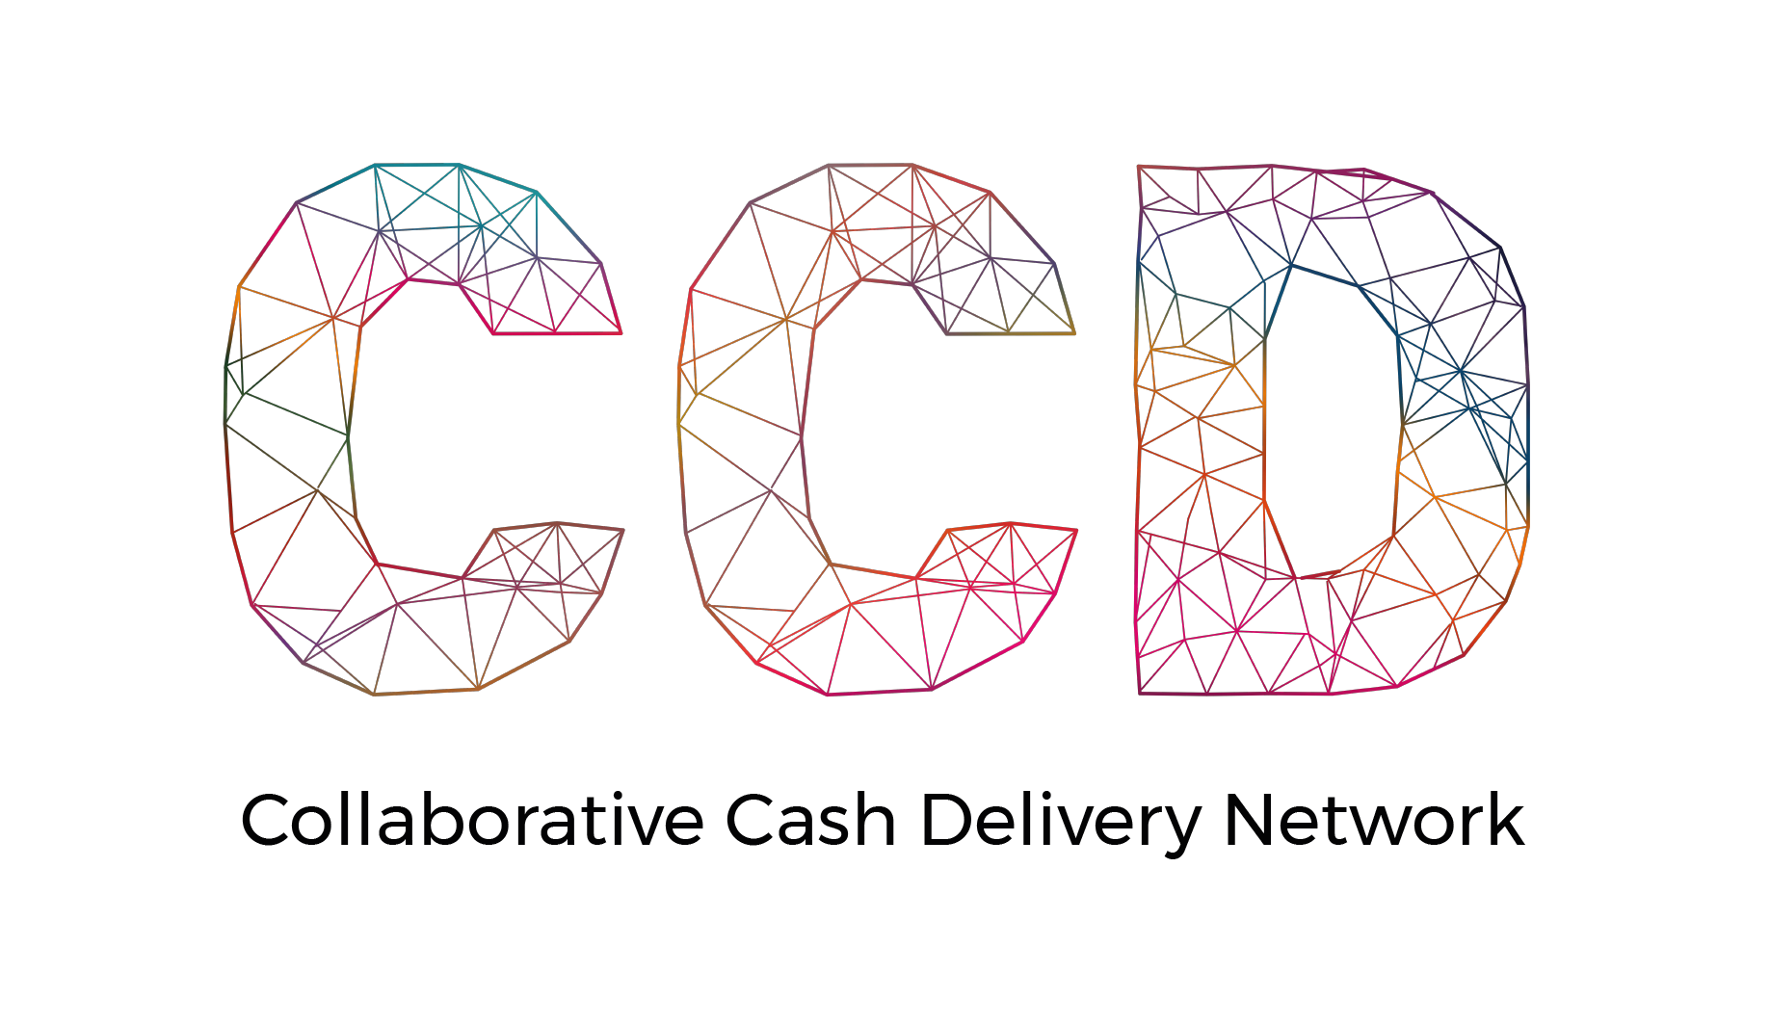
find a better way to meet humanitarian needs
improve delivery of cash programming
deliver scale and preserve diversity in the humanitarian ecosystem
influence the changing humanitarian landscape
OUR
PURPOSE
TRANSFORMATION
Notes:
These 15 NGOs founded the CCD network in the wake of the Grand Bargain's 2016 annual meeting and envisioned a way to deliver aid collaboratively. It is an approach that allows multiple actors (beyond NGOs) to assemble themselves in ways that are tailored to the needs of each response and better achieve our objectives. As such, CCD partners are committed to transforming the delivery of cash programming within the aid ecosystem through the collective impact of cash programme delivery.
CCD members believe greater collaboration will enable the humanitarian sector to bring the best available actors in a given context into adaptive cash and voucher assistance (CVA) partnerships that deliver timelier and more impactful CVA to people affected by crises.

Slide 4
improve efficiency and effectiveness of cash programming to better serve affected populations through faster setting up of consortiums
avoid duplication and make the most out of resources
enable technical challenges to be addressed faster
strengthen NGOs’ voice on advocacy issues
OUR
OBJECTIVES
COLLABORATION
Notes:
Partners in the CCD network are establishing norms of collaboration across the CVA value chain and increasing opportunities to work together. Within each country, the network forms rapid, reliable partnerships that share responsibilities and harness the best of each organisation to improve the efficiency and effectiveness of our cash programmes to:
better serve affected populations
avoid duplication
address technical challenges more effectively
capitalise on the strengths of each actor
and harness the power behind combined voices to influence advocacy.

Slide 5
OUR
STRUCTURE
strategic
technical
operational
THREE-PRONGED
Notes:
The CCD is more of a commitment to a horizontal way of working and works in three dimensions (strategic, technical, and operational) globally and nationally. CCD collaboration is bigger than a single project and aims to create long-standing, reliable systems and tools that can be leveraged for faster and more efficient responses over time, whether through consortiums or other ways of working.

Slide 6
STRATEGIC
CCD is a collaborative network of like-minded NGOs working in cash programming within the humanitarian sector. We aim to enable an all-inclusive network that includes all humanitarian actors responding to crises with cash, but, at the moment, CCD is focused on developing partnerships between international and local NGOs.
Notes:
CCD is being strategic in its focus of initially partnering with likeminded NGOs during this phase of our collaborative efforts. While we aim to enable an all-inclusive network that will include all humanitarian actors responding to crises with cash, because NGOs are able to be more flexible when it comes to developing partnerships and adjusting approaches in a variety of contexts to develop cash transfer programmes, they can:
find better ways to meet humanitarian needs
improve efficiency and effectiveness of cash programming
deliver scale and preserve diversity in the humanitarian network
influence the changing humanitarian landscape.
Strategic approaches within the national network can include:
the design of the governance framework and ways of working of the members
the design of the decision paths for joint proposal submissions
prioritisation of issues
coordination of fundraising asks and advocacy campaigns, etc.

Slide 7
TECHNICAL
CCD allows partners to share resources across responses, with strong technical and coordination backstopping.
Notes:
Working with organisations with such a rich competency and familiarity with cash and voucher technology will enable the team to pull their capacities and innovations together. CCD members can share technology and systems without being a part of a project or consortium within the network. This also reduces costs; as when partner agencies share data, both programme teams have insight into each other’s beneficiary lists so they can avoid duplication across programmes.
A proof of concept can be seen in the national network set up by the CCD in Ethiopia, where they were able to accomplish this with their use of World Vision’s Last Mile Mobile Solutions (LMMS) digital tool to collect beneficiary data and serve as a single beneficiary digital database for the entire Ethiopia CCD coalition.
Technical approaches within the national network can include:
addressing specific cash programming related challenges
creating, using and sharing approved tools and norms
improving capacities of the organisations around the cash value chain (closely linked with the operational dimension)
creating a single cash-delivery platform
signing a data-sharing agreement
jointly contracting an FSP (financial service provider)
linking up with the global social protection working group

Slide 8
OPERATIONAL
An in-country CCD network provides an umbrella for smaller constellations of international NGO members to establish dedicated collaborative cash consortia for specific projects, locations and/or donors.
Notes:
The CCD has been working on two levels – the first is at the global level with the development of products, services, and tools that can be used in CCD collaborations around the world and the second level is at the country level, setting up CCD country platforms and developing a model for how that works. All work thus far has been accomplished through internal partner funding and pro-bono support.
At the national level, the collaborative operational model that has been developed as part of this process simplifies the contracting process and lowers the administrative burden, therefore reducing overheads.

Slide 9
NATIONAL NETWORKS
scoping
startup
functioning
established
MULTI-STAGED
Notes:
We have found that there are distinct stages that we go through while working towards an established CCD in-country network. These stages are flexible and dependent on each country’s context as we conduct additional pilots and existing CCD country level platforms mature and grow.

Slide 10
SCOPING STAGE
An interest in exploring the set up of a CCD in a specific country is raised; either by the global CCD core team or decision makers, by global CCD member(s), by CCD member(s) operating in country, or encouraged by donor(s).
Notes:
Countries with active cash communities that have expressed interest in learning more about CCD or have taken it to the next step of exploring opportunities of how it could work in their context are in CCD’s “scoping” stage. For the most part, this is happening organically as information about the CCD is shared with CCD member organisations’ in-country programme teams. This is either initiated by the CCD global cash team in a CCD member organisation reaching out to their country counterparts or vice versa as field offices inquire about the network and the opportunities it can offer at the national level. This stage includes introductory meetings and presentations explaining the CCD to key stakeholders in country. The objective is to socialise humanitarian actors working in the cash field to the concept of the CCD and identify an anchor (acting focal point) in country to facilitate the startup stage of the CCD.
Actions:
CCD’s in-country support shares information about the CCD with the interested organisations.
The interested parties gather inputs from different organisations operating in country (either at the global or at local level) to gauge interest and identify potential barriers and enablers.
The CCD country-support identifies a focal point in country - or “anchor” - in close connection with those who have expressed an interest to support a national CCD network.
If no major barrier is identified, the anchor is encouraged to start working towards building the national network.

Slide 11
STARTUP STAGE
The anchor starts building the network through in-depth outreach and socialisation with CCD members and other NGOs working in the cash sector in-country to gauge interest and identify priority issues.
Notes:
Once an anchor (a national office of a global CCD member organisation) volunteers to serve as a convener of other global CCD members operating in country to gauge interest level and identify priority issues, the country moves to CCD’s “startup” stage.
The objective of this stage is to form a core group of NGOs and agencies who are interested in setting up a national network to work collaboratively and then work, either consecutively or simultaneously, to analyse the context, understand their agencies’ cash capacities and gaps in expertise, define common interests and needs, develop good relations between the members, and outline a solid action plan.
Actions:
At this point, the anchor may:
present to the local cash working group about CCD
host a CCD scoping meeting
or meet one-on-one with the national teams of the other in-country CCD members.
To prepare for these presentations and meetings, the Anchor is encouraged to reach-out to CCD’s country support staff, Gaby Viat, to obtain material (some of it is still under development) or visit our website to download materials from our toolkits.
Available materials include:
3 pager (introduction to CCD)
CCD global collaboration agreement
answers to FAQs
this “field presentation” PPT for introducing CCD to field offices and in-country operations
“how to set up an in-country network” guidelines.
Materials under development:
TORs for the anchor (to develop)
link CCD/CWG (to develop)
example of activities to be undertaken (to develop).

Slide 12
STARTUP STAGE
NETWORK
Members agree that a local CCD network is appropriate and start working on its details/design. This may include:
identification of priority areas and gaps
drafting of a memorandum of understanding (MoU)
preparing a governance framework
agreeing on how to work alongside the local cash working group (CWG).
Notes:
When they decide that starting up a network is feasible within their context, usually in parallel with the implementation of a collaborative activity or project, members will start looking into the design/details to formalise their national CCD network. This is when a Collaboration Facilitator (a temporary role (usually between two to six weeks) meant to help the new CCD members kickstart operations) will be deployed to conduct a CCD design workshop. This may take a few rounds of meetings with the Collaboration Facilitator(s), depending on number of CCD members involved and the complexity of environment.
Actions:
The Collaboration Facilitator conducts a CCD design workshop with interested stakeholders.
Each organisation or agency maps their capacities along the cash value chain and their geographic footprint.
The group identifies priority areas for collaboration and looks at governance structures, norms and key next steps needed to maintain momentum.
However, all CCD networks are different, from the level of collaboration wanted, the types of activities undertaken, the governance defined, the way they link with the work being done by the local cash working group, and more. That is why the design phase is essential so members can agree on the specificity and details of how their particular CCD Network will operate, taking into consideration the context in which it is implemented.
Actions:
Together, the group will formalise the national network. This may include:
identification of priority areas and gaps
drafting a memorandum of understanding (MoU)
preparing a governance framework.
Identifying priority areas for collaboration and gaps needs to happen at all three levels of the collaboration model structure. Guidelines for leading these discussions are being developed at the global level with input and experiences from our pilot networks. They will include a (non-exhaustive) list of the areas and activities for each level (strategic, technical, operational). We also have a tool that can be edited to fit your context to help you map each members’ operational capacity, expertise, and geographical footprint. It will help identify the strength of each organisation along the cash value chain as well as where they implement their programming geographically. This will help you build consortia transparently as the network can decide who to include based organisational strengths and reach.
Developing a MoU for signature by all members should happen as soon as possible to seal the willingness of member organisations’ leadership to formally work together. New countries are encouraged to use Ethiopia’s MoU as a starting point to work from and adapt it to your contexts (based on the previously identified priorities and gaps). A tool is also being developed to help in country networks lead the discussion around how to develop this document.
We also advise that countries follow Ethiopia’s example and work on your governance framework in parallel while you draft your MoU.
Designing a governance framework is a big piece of work as it sets the rules that members agree to follow to make the CCD a successful network, enabling efficient and transparent collaborative activities. Ethiopia developed a thorough framework that can be used as a reference by new CCD networks, namely, it can help you identify the different aspects to consider, but each network will need to adapt these to their own context and appetite for collaboration.
Typically a framework is organised into four parts. The first being an introduction to provide a background and timeframe, the second giving the levels of governance within the collaboration model structure, followed by a summary and then details of the tools and documents for development. Here is a non exhaustive list of the aspects to be considered as part of the governance framework (and sub-docs to be developed):
ToR of the Steering Committee
ToR of the Technical Working Groups
ToR of the Collaboration Unit
guidelines for setting-up of consortia*
defining process for new proposal submission*
guidelines for integration of new members
financing of the CCD
communication/reporting rules
setting up next steps
creating a calendar
*It is important to note that defining a process for new proposal submissions and guidelines of setting up of consortia are 2 pain points. They will require quite a lot of discussions, back and forth, negotiations, etc. Specific tools to help design those are under development. When available, you can find them in the toolkits section of our website.
Agreeing on how the national CCD network will work in relationship with the CWG (and maybe other coordination bodies if necessary, such as sectoral projects, international NGOs, etc.) is extremely specific to countries. The level of implication of the CWG will also inform the objectives of the in-country CCD. If many technical aspects are already taken care of by the CWG in a collaborative manner, then CCD members should simply confirm their willingness to take part in the CWG’s work, but there is no need to set up parallel working groups. Though, CCD can take responsibility of technical aspects that the CWG has not yet been able to broach and share their solutions with the CWG. CCD is also able to facilitate faster development of technical, harmonised tools to support the CWG in that it will develop tools for its consortia, get them validated by the national CCD network (through the steering or technical committees); then share them with the CWG ,which can then promote them without needing to wait for all the typical approval processes of the CWG and sectors to start using them.
CCD, however, has a whole operationalisation aspect (namely in term of setting up consortiums) that is unique and out of scope for a CWG, which makes it an entirely different network with no duplication possible. A tool is under development to help each country think through this and identify points of convergence, common topics, and defining activities that are specific to the CCD and those that are specific to the CWG.

Slide 13
STARTUP STAGE
PROJECT
Members agree that working collaboratively is appropriate and start looking for opportunities to work collaboratively. Some ways to do this include:
writing proposals cooperatively
conducting joint assessments and analysis
coordinating donor asks
setting up a consortium
agreeing on common approaches for cash delivery
advocacy
financial service provider mapping, contracting, etc.
Notes:
A CCD Network usually starts when there is a specific opportunity for a collaborative approach, such as a need for a joint assessment or a funding opportunity. Members then decide to work together to pilot their ability to work in collaboration and build trust. This can be a prelude to the setting up a formalised CCD. Activities can take place at various levels within the collaboration structure:
Strategically:
Members can work together to advocate for cash programmes in their context with donors or the government.
Technically:
Members decide on a common approach for cash delivery (for example, selecting criteria for a minimum expenditure basket). (If this isn’t already managed by the cash working group (CWG); otherwise this should be coordinated with them.)
Operationally:
Members can connect to undertake joint assessment and analysis.
This is how Ecuador started. They came together to work on a joint assessment and then cooperatively evaluated the data at a workshop where they drew a common analysis. During this activity, members realised they worked well together and gained time and resources. Following this experience, they decided to formalise a CCD.
Members can come together in specific contexts and situations to set up a consortium.
In Ethiopia, members worked together to establish a consortium after embarking on a joint assessment to understand the situation in one region of the country (in which many members participated). An agency was identified to lead the consortium and 4 other agencies were selected to participate (based on their geographical footprints).
Although members may decide to embark on an activity before formalising the CCD, they can still take advantage of existing CCD tools, namely the capacity matrix to identify gaps or the best positioned members in the event they want to set up a consortium.

Slide 14
FUNCTIONING STAGE
The group starts building itself as a core group and determines how they will operate, develop relationships, and put key foundational places in place within their context.
Notes:
Once these are in place, the national network progresses to the CCD “functioning” stage when interested parties and the anchor decide (either concurrently or consecutively) that working collaboratively is appropriate and start a collaborative activity or agree that a local CCD network would be a value-add and start working on its details/design.
The in-country CCD will now engage a full-time Collaboration Manager (a permanent in-country position that takes over operations once the Collaboration Facilitator’s function is complete) to assist with finalising a memorandum of understanding, data sharing agreement, establishing key norms for the network, and identifying and addressing the key priority issues identified by the core group. With the CCD manager in place, the role of “anchor” can be retired as the role shifts to the steering committee (a group comprised of a few representatives to make decisions, represent the CCD in country, establish priorities for the local network, and act as the voice of CCD’s national members).
The objective of this stage is to put key agreements in place, set up governance, agree on key norms, standardise ways of working, and address key priority areas identified by the core group. A CCD is considered to be in the “functioning” stage during their first year of operation. While the core group will establish key “norms” at this time, the group will likely encounter new situations that require additional norms and expectations to be developed as they move forward and find new ways to work together.
At this stage, membership could be opened to include a broader group of actors. However, we recommend that membership remain limited to just the initial interested parties and CCD members operating in country who are invested in the process and have a good working relationship while standards are being set and decisions are still being made about how best to work together. Opening membership at this stage could prove to be challenging with the addition of new perspectives before the initial “norms” are set by the core group.

Slide 15
ESTABLISHED STAGE
The group has been actively engaged and operational for two years or longer.
Notes:
As our pilot networks move towards this stage, CCD will further define what a sustainable, effective “established” stage means for a national CCD network.
However, in general, the objective of this stage is to provide sustainable, effective, and valuable service to members by improving the efficiency and effectiveness of each member’s operations.

Slide 16
OUR ACCOMPLISHMENTS
Notes:
We are finding that when organisations collaborate using the same process and standards, greater efficiency can be achieved.

Slide 17
successfully replicated national network model
data sharing guidance, agreement template, and working group
collaboration guidance, toolkits, and online modelling tool
global collaboration agreement
social protection working group
GLOBAL PROJECTS
Notes:
With this, since its inception, CCD has made significant strides towards its goal of harnessing the potential of the best available actors, in a given context, in order to reduce competition and costs while maximising impact at the field level. The network is continuously looking for ways to bring the most relevant experience and expertise together in order to generate value for in-country collaborations.
Over the past two years, the CCD has conducted several field pilots, developing what we consider to be a viable, sustainable, easily replicable model. The global team is developing a startup kit that includes the necessary guidance and materials for any new countries to get a CCD network up and running in country. There is still a lot of learning to do, but we feel like we have a solid model and will now shift our focus to helping 10 new CCD country networks get set up within the next year.
In 2018, CARE, with the support of the CCD, hosted a data event in San Francisco to look at key data issues facing humanitarians. One of the plans to come out of that event was a project looking at data sharing agreements. CARE secured the support of Denton’s law firm, one of the world’s largest law firms, who helped CCD develop practical guidance on data sharing as well as a data sharing agreement template. The guidance and template are based on the highest data standards (GDPR) and CCD members’ legal counsels, data specialists and programme teams provided feedback on the guidance and agreement template to ensure that it can be used easily by CCD members in the field. Both have been utilised by CCD pilot collaborations in Ethiopia and Colombia.
The template is a general data sharing agreement that will remain the same for each country but can and should be adjusted to the context based on the local collaboration, what data they want to share, and the local legal requirements. Once the template is adjusted accordingly, it must be reviewed by a local legal counsel before each agency signs. As the template is adjusted, reviewed and approved by the legal counsels of each CCD member, the review and approval process will become easier and streamlined over time in future collaborations.
Now that we have some experience with the mechanics of data sharing between agencies, we are starting to look deeper at other aspects of data sharing to ensure that the ways we are doing this is in the best interest of our beneficiaries. Thus, we have developed a data-sharing working group to investigate the possibilities of a ‘data trust’ to host the information but also ensure vulnerable people have access to their own data and there are limitations in place on how data is collected, shared, stored, and kept.
Since 2018, the CCD has developed guidance, together with our global partners, on how to design a cash collaboration. This guidance outlines key steps and decision points for developing and customising a cash collaboration model, which is being further developed and piloted as part of collaboration toolkits and an online modelling tool. With the support of Pivotal Labs, this guidance will form the basis for an online tool that provides CCD members a collaboration sandbox where they can quickly model different collaboration design choices based on the guidance and best practices. This tool will help CCD Collaboration Facilitators and Managers to support CCD members to design, set up, and establish CCD networks and collaborative projects in the field. It will also be useful for CCD country platforms interested in scenario planning. Additionally, CCD has created toolkits aligned with each level of collaboration maturity that in-country networks can download and use at each stage of the collaboration process. Each module is divided into sections and sub-sections and can be used sequentially or as needed by the collaborators.
In June 2019, the Grand Bargain – a facilitation group made up of global humanitarian leaders from Sweden, the US, OCHA, UNICEF, IFRC and InterAction – held their annual meeting. At this, a letter of intent, the Global Collaboration Agreement, endorsed by the CEOs of CCD’s global partnership was released. With this statement, each organisations’ CEO, reaffirmed their commitment to greater collaboration to ‘deliver timely cash and voucher assistance to people affected by crises’ in partnership with other CCD network members. The statement said that, alongside our vision of ‘collective impact that leaves no one behind’, these organisations have a ‘shared belief that collective cash programming should always respond to the local context, strengthen local capacities and ensure a community-focused approach’. With this agreement, senior leadership with CCD network’s partners reaffirmed their organisation’s commitment to greater collaboration to enable, facilitate and drive a shared CCD vision, agenda and operational support to harness the efficiencies of working together.
In response to a number of external stimuli, including:
the growing caseload and burden on humanitarian responders to act for longer periods of time, as a result of climate change and conflict, in protracted crises
increased pressure on donors to support, despite budget limitations, the growing needs resulting from the protracted crises
the need to put social protection systems in place to accommodate donors with better planned and more sustainable responses
donors' shift towards ‘single delivery mechanisms’ (a model that has one responsible agent delivering a humanitarian cash programme with partners providing monitoring and accountability functions) by channelling cash through existing local systems, where feasible
a push from international commitments (particularly the Grand Bargain that signed a localisation agenda to re-balance power and resources towards the Global South) to use formal or informal social protection models in local systems' operations to complement global approaches
CCD established a social protection working group in 2019, led by OxFam. As this shift affects all NGOs, CCD believes it is beneficial for our members to work together to explore the new roles we can play in this arena, where we can continue to influence the humanitarian sector, and how we can guarantee the delivery of the best possible cash and voucher assistance for people affected by crises. The social protection working group will ensure that we stay up to date with the growing focus on social protection in humanitarian response, see how our country platforms can add value to social protection programming and policy, make sure that we contribute to the ongoing learning around social protection, especially in fragile contexts.
The group's mandate includes:
sharing information
supporting and learning from each other defining what international NGOs' role can be in social protection within humanitarian responses and influencing this emerging area
providing a safe space for colleagues to openly discuss social protection issues
identify any capacity gaps within CCD member organisations and collaborating to fill these spaces
looking for joint opportunities to work together.
The group has put together a workplan and begun to engage externally with in-country CCD partnerships on ways to collaborate. CCD's social protection team's workstream includes:
mapping social protection opportunities in countries where CCD collaborations are functioning or starting up
mapping of social protection in CCD countries and CCD's members' work on the topic
providing a safe space for idea sharing
establishing how CCD can add value to social protection work in CCD countries.

Slide 18
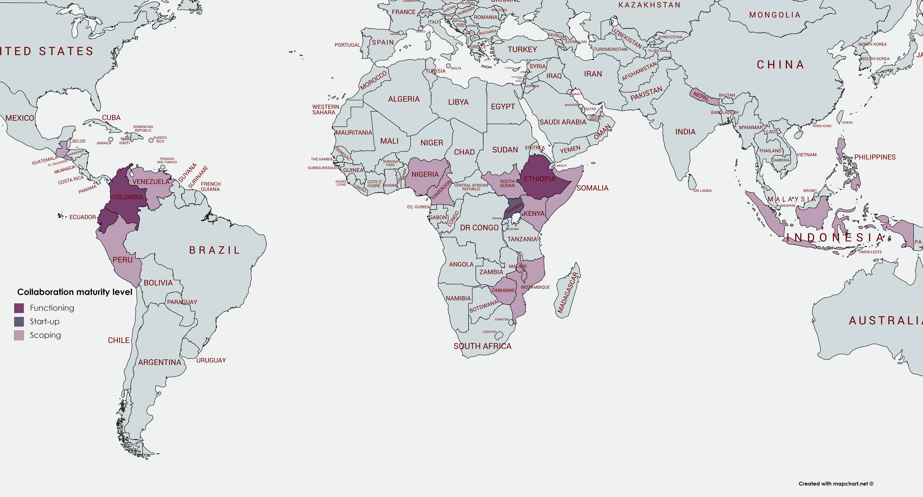
Notes:
Over the past two years, the CCD has conducted several pilots in different countries as we have developed our collaboration model. We have nearly 20 countries from Latin America to sub-Saharan Africa to Asia in various stages of the collaboration process.
Colombia, Ecuador, and Ethiopia all have functioning national networks.
Uganda is in the startup phase.
15 other countries have expressed an interest or have begun exploring opportunities for a national network. These include:
Cameroon, El Salvador, Guatemala, Indonesia, Kenya, Malawi, Mozambique, Nepal, Nigeria, Peru, Philippines, Somalia, South Sudan, Venezuela, Zimbabwe

Slide 19
12 members
ECHO-funded consortium
established a technical ‘Collaboration Unit’ that operates in support of all members and is led by the in-country Collaboration Manager
PILOT NETWORK
ETHIOPIA
Notes:
Ethiopia was one of the first countries set up as a pilot to test CCD’s collaboration model to define a better way to collaborate in Ethiopia. 12 of CCD’s 15 global members are part of CCD Ethiopia (ACF, CARE, Concern, CRS, DCA, DRC, IRC, Mercy Corps, NRC, OxFam, Save the Children, World Vision).
CCD Ethiopia’s framework was devised using the three-pronged structure.
Strategically, they defined what leadership looks like in their network’s context and how it would be decided within the group. They created an elected steering committee that is coordinated by the Collaboration Manager. Topics they prioritised, include advocacy, annual planning, new member requests and invitations, CCD proposal endorsements, etc.
The aforementioned ‘Collaboration Unit’ manages the technical aspects of the network. It will be governed and supported by all CCD members and provide services to all CCD members (regardless of consortia participation). They will create ad hoc technical working groups to address specific aspects that arise (either from a CCD consortium programme or other programmes led by CCD members), create harmonised tools and approaches, work on financial service provider contracting, draft data-sharing agreements, etc. It will also be supervised by the Collaboration Manager but made up of technical staff from CCD Ethiopia’s partner organisations. In the long run, they envision this being a resource pool where a CCD partner can pay to use another partner’s human technical resources on a need by basis.
Operationally, the network put in place rules about how consortia will be set up and decisions made regarding project participants.
While they worked to establish their in-country network, CCD Ethiopia moved forward with a collaborative grant proposal. After completing the capacity matrix, the network identified the best positioned organisations to participate in a collaborative project for an ECHO proposal. Led by World Vision, a consortium of 4 implementing NGOs was created along the cash value chain (registrations, delivery, monitoring) and geographical footprint, which led to 2 organisations running registration in 2 different areas. A component was also added to kick off the CCD Collaboration Unit (for collaboration manager salary, joint assessments, technical topics, etc.).
(As of November 2019) All CCD Ethiopia partners have signed an MoU, the governance framework has been finalised, norms are under development, and a steering committee has been put in place.

Slide 20
9 members
OFDA-funded collaborative cash programme
data-sharing agreement in place and shared beneficiary data and case management system underway
supporting broader humanitarian cash community
PILOT PROJECTS
COLOMBIA
Notes:
The CCD Colombia network was formed in January 2019 and has nine NGO members (ACF, ACTED, CARE, DRC, IRC, Mercy Corps, NRC, Save the Children, and World Vision).
CashCap supported the in-country network with the deployment of a dedicated manager and MEAL officer which helped guide the collaborative efforts of the network and steering committee as they agreed, monitored, and adjusted strategic directions for the network and its technical working groups while identifying the added value of CCD within their country’s humanitarian context and cash and voucher landscape.
The Office of US Foreign Disaster (OFDA) funded a multi-purpose cash programme that will serve approximately 160,000 people over 18 months. This project kicked off in late 2019. CCD Colombia is currently focused on the setup of an internal and external operational network structure and establishing standards for the implementation of this programming.
CCD Colombia is using the data sharing agreement created by CCD’s global network and drafted by the Denton’s law firm. The Colombia CCD is also supporting its members (ACF and Mercy Corps) in their efforts to procure a shared beneficiary data and case management system (BenReg) with a dedicated technical working group that consolidated programmatic and technical specifications to customise the platform to best meet the business needs. With the highest level of data protection, the data-sharing agreement and BenReg will allow members to exchange and cross-check beneficiary data to identify, address, and prevent the duplication of assistance and enable referrals across member organisations.
CCD Colombia and its members are committed to actively coordinating with and contributing to the work and capacity development of the broader humanitarian cash response in Colombia. As part of this approach, the CCD is:
active in the Colombia cash working group (CWG) – four of the network’s members (ACF, NRC, DRC, and Save the Children) are on the steering committee, representing the NGO community alongside UN agencies and the government of Colombia
co-leading the MEAL technical working group and its sub-groups
coordinating with World Food Programme and UNHCR to design a common architecture that will allow data exchange and interoperability of the systems for de-duplication and referral pathways
prepared and facilitated (in collaboration with CaLP and the Colombia CWG) a certified fundamental training and training of trainers session in July 2019 for participants from NGOs and UN, donor, and governmental agencies
contributed at an executive level to discussions on coordination of cash assistance and articulation of emergency cash response with social protection at the CWG’s two-day workshop with the Colombian government, donors (including the World Bank), and UN agencies.
CCD Colombia members are also leading the effort and mobilising other local cash working group members to finalise development and validation of the following tools that will be used as the norm for implementing cash transfer programming within the CCD network and beyond:
eligibility criteria and questionnaire
end and baseline indicators
accountability
risk and mitigation measures.

Slide 21
Contact
CCD country-level support: www.collaborativecash.org/contactus
QUESTIONS?
Learn more about CCD at www.collaborativecash.org

