Slide 1
Products & Services Workstream
February 2020

Slide 2
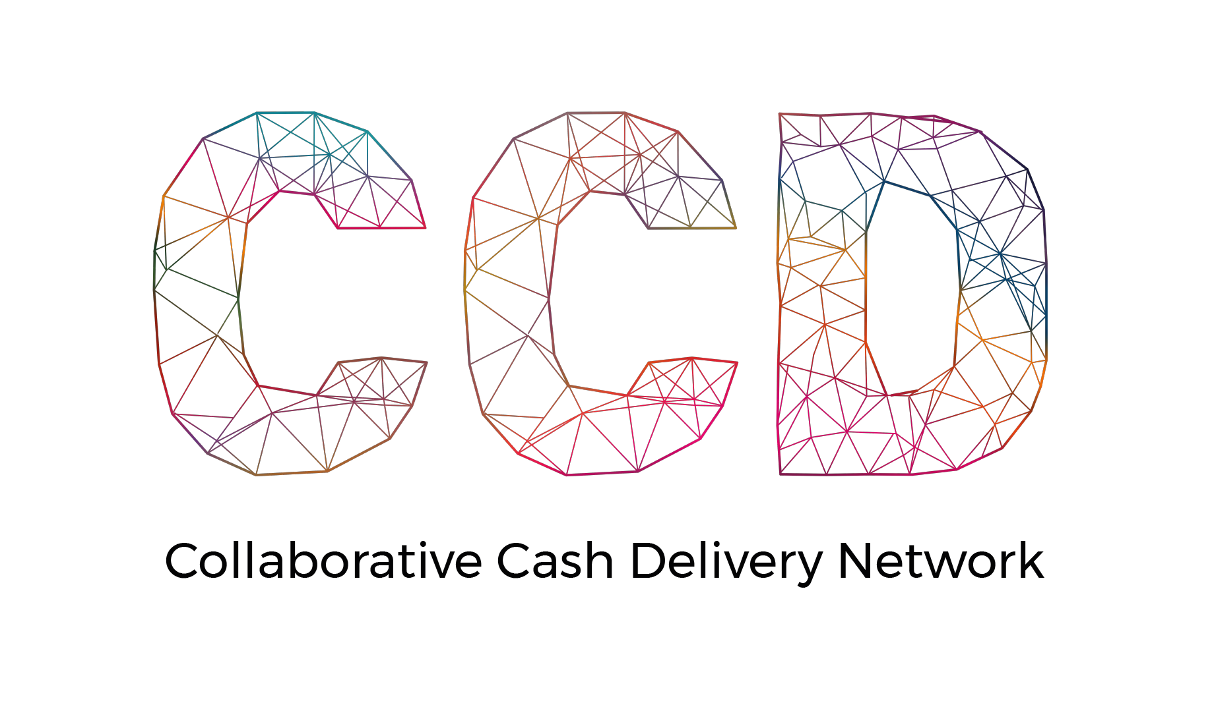
find a better way to meet humanitarian needs
improve efficiency and effectiveness of cash programming through collaboration
deliver scale and preserve diversity in the humanitarian ecosystem
influence the changing humanitarian landscape
OUR
PURPOSE
TRANSFORMATION
Notes:
Our members believe greater collaboration will enable the humanitarian sector to bring the best available actors in a given context into adaptive cash and voucher assistance (CVA) partnerships that deliver timelier and more impactful CVA to people affected by crises.
Our goal is to transform CVA to find a better way to meet humanitarian needs and influence the changing landscape by remodelling the way organisations collaborate around cash and voucher programming. Through a widely adopted and consistent platform of collaboration standards, complemented by facilitated partnership brokering, we strive to work together seamlessly. Actors will be able to combine the best of their strengths to meet the complex challenges of humanitarian response quickly and easily. We endeavour to move the cash landscape from a disconnected patchwork of dominant actors to an evolving ecosystem that reduces barriers to entry, generates greater impact and is constantly adapting to the future operating environment.

Slide 3
WE PROMOTE AND SUPPORT EASY, CUSTOMIZABLE AND SCALABLE COLLABORATION ACROSS THE CASH VALUE CHAIN
OUR
OBJECTIVE
COLLABORATION
Want to know more about collaborative cash? Scan for more details about CCD’s approach .
Notes:
CCD promotes and supports easy, customisable, and scalable collaborations across the cash value chain.
Partners in the CCD network are establishing norms of collaboration across the CVA value chain and increasing opportunities to work together. Within each country, the network forms rapid, reliable partnerships that share responsibilities and harness the best of each organisation to improve the efficiency and effectiveness of our cash programmes to:
better serve affected populations
avoid duplication
address technical challenges more effectively
capitalise on the strengths of each actor
and harness the power behind combined voices to influence advocacy.

Slide 4
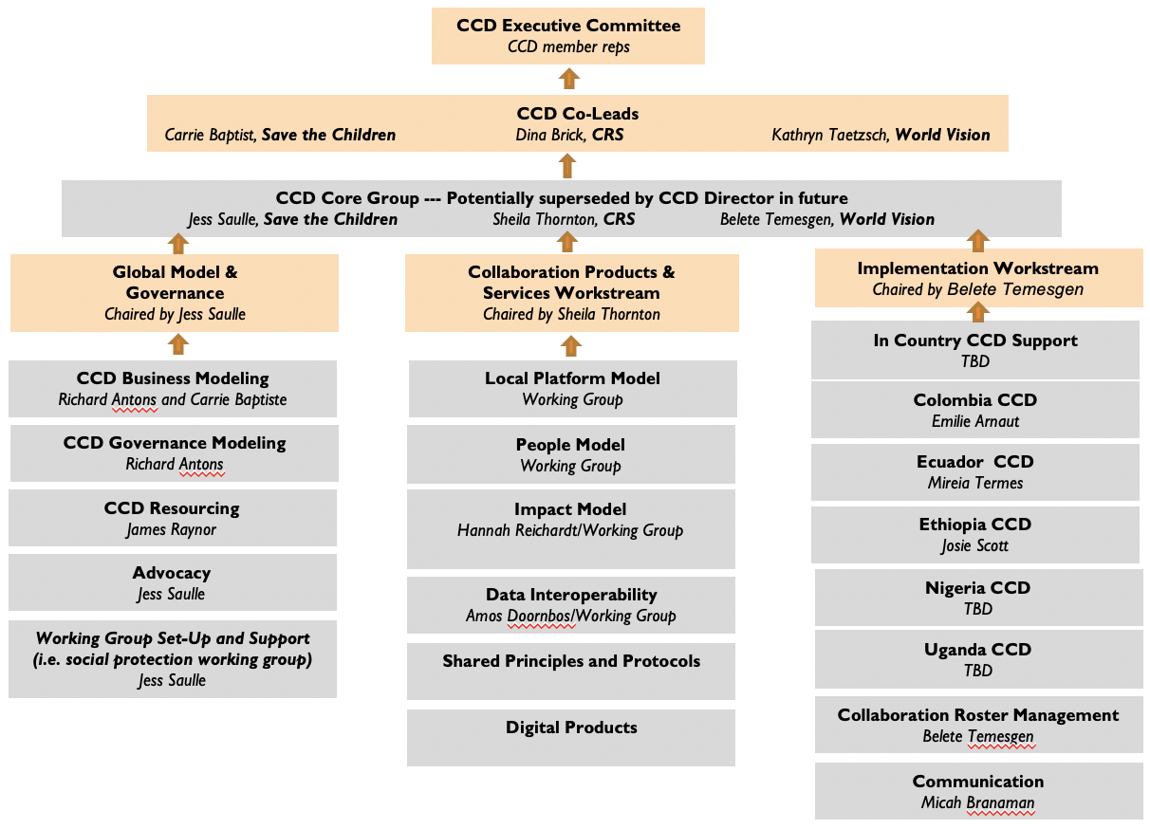
What does the CCD look like at the global level?
Notes:
GLOBAL MODEL & GOVERNANCE
Staffing for CCD
Interim MoU
Business model development
Governance structure
Membership services
COLLABORATION PRODUCTS & SERVICES
Local CCD Model (“franchise”)
Collaboration Toolkit
People Model
Training curriculum development
Conducting training
Roster development
Impact Model
Impact model
MEAL framework
Evaluations
Data (Interoperability)
Data sharing agreement finalization and pilots
Ongoing technical assistance as needed
Data trust research and development
Supply Chain (Interoperability)
Research and piloting common procurement standards, framework agreements and other solutions
Digital Products
Modeling tool
Marketplace mapping
Collaboration analytics
Overall response environment analytics
IMPLEMENTATION
Year One: 5 CCD platforms opened
Year Two: 10 CCD platforms opened
Year Three: 15 CCD platforms opened

Slide 5
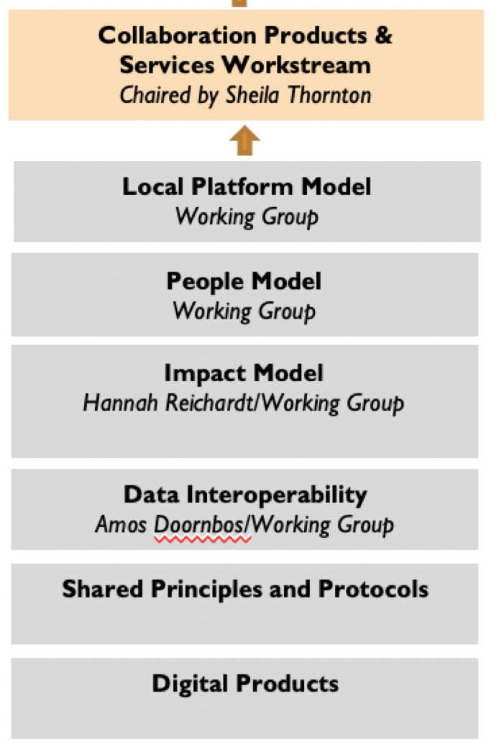
Local Platform Model (“franchise”)
Collaboration Toolkit
People Model
Roster development
Training curriculum development
Conducting training
Impact Model
Impact model
MEAL framework
Evaluations/case studies
Data Interoperability
Data sharing agreement finalization and pilots
Ongoing technical assistance as needed
Data trust research and development
Shared Principles and Protocols
Making systems more conducive to collaboration
Reducing management costs, centralising capabilities
Digital Products
Modeling tool
Marketplace mapping
Collaboration analytics
Notes:
Local Platform Model: This area of work refers to products and services that support the design and management of the local CCD platform as well as the design and management of collaborative operations. The primary product from this work area is the collaboration toolkit. The Collaboration Toolkit is based on practical experience in local CCD country platforms and provides guidance, tools and resources to help facilitate operational collaboration between CCD members. The goal of the toolkit is to promote collaborative approaches which the CCD believes will make cash programming more effective, improve operational efficiency and amplify impact. The toolkit covers the set-up and management of CCD country platforms, the set-up and management of collaborative cash operations and the partnership brokering/interpersonal skills needed to successfully collaborate.
People Model: This area of work refers to the development of a pool of collaboration experts. It includes the set-up and management of the expert pool as well as the development of expert profiles, a recommended learning path, training curriculum development and hosting of trainings. It may also include mentoring, accompanied deployments and other types of services as we learn more about how best to support our collaboration experts in the field.
Impact Model: This area of work refers to the creation of the overall impact model for the CCD Network, local CCD platforms and the operational collaborations members engage in. It includes the accompanying MEAL framework and the collection of key metrics based on the framework. This area of work includes building the evidence base of what makes good collaboration including case studies and evaluations.
Data Interoperability: This area of work refers to local CCD platforms developing an ecosystem where all cash actors are able to securely and seamlessly access data to meet the needs of affected people. An initial product includes practical guidance on data sharing and a data sharing agreement template. The guidance and template are based on the highest standards (GDPR) and CCD members’ legal counsels, data specialists and program teams are providing feedback to ensure it can be used easily by CCD members in the field. Another area of work includes researching and possibly piloting a Data Trust. A Data Trust is an innovative way to see data as a shared resource that is available to everyone and balances individual, collective and societal interests.
Shared Principles and Protocols: This area of work refers to finding ways to make CCD members’ systems and protocols more conducive to collaboration. This work includes looking at ways to reduce management costs where possible, centralising capabilities and sharing capacities rather than duplicating them. This area of work also includes development of common standards for interoperability, including finance reconciliation, reporting, a common partner agreement framework and common due diligence parameters. Currently this area of work has not been initiated at the global level, but some experimentation is happening at the country level. With additional resources, this work area could be initialized and expanded.
Digital Products: All Collaboration Products and Services are initially developed, iterated and operationalized off-line. If there is demonstrated added value, some products or services may be digitized. The type of value that digitization can bring includes making tasks quicker/easier, allowing products or services to scale, collecting collaboration data more systematically to build evidence base, and promoting a common language and framework across multiple local CCD platforms. The first CCD digitized product is ResponseBuilder, a collaboration modeling tool which was developed based on collaboration managers field experience and the CCD Practical Guidance for Building Collaborative Operational Models.

Slide 6
Local Platform Model (“franchise”)
Collaboration Toolkit Working Group
NEED FUNDING TO DEVELOP TOOLKIT COMPONENTS
People Model
Expert Pool and Collaboration Training Working Group
NEED PEOPLE TO DEPLOY
Impact Model
Impact Model/MEAL Framework Working Group
NEED FUNDING TO DEVELOP MEAL TOOLS
NEED FUNDING FOR EVALUATION
Data Interoperability
Data Interoperability Working Group
NEED FUNDING FOR DATA TRUST RESEARCH/PILOTS
Shared Principles and Protocols
Not active at global level currently
Digital Products
Decision-Making Group for next round of development
NEED FUNDING FOR ADDITIONAL DEVELOPMENT

Slide 7
P&S leads development of products & services; mainstreams innovations from the country level
Implementation pilots products & services; shares innovations from the country level
PRODUCTS & SERVICES WORKSTREAM
AND
IMPLEMENTATION WORKSTREAM

Slide 8
THANK YOU
collaborativecash.org

